Slide 1


Slide 2


The Lasallian days of Peace begins on September 21st, which is the International day for Peace and culminates on the 21st October which is widely known as the Lasallian day for peace.
This month we encourage you to think about the theme,
‘1 La Salle, our pilgrimage towards Peace.’
To help with this, you will find a range of peace related resources which are here for you to use as you wish. Following an initial introduction the resources sit in three categories: Be still and pray, The Lasallian Global Mission, and Create for Peace. Feel free to pick and mix resources to assist in a meeting, an assembly, during prayer and liturgy or for special group workshops.
Please look out for our special invitation too to learn more about Bobble, a story of courage, compassion and love brought to you by Asylum Speakers.

Slide 3

An introduction to the International Lasallian days of Peace 2024

Slide 4
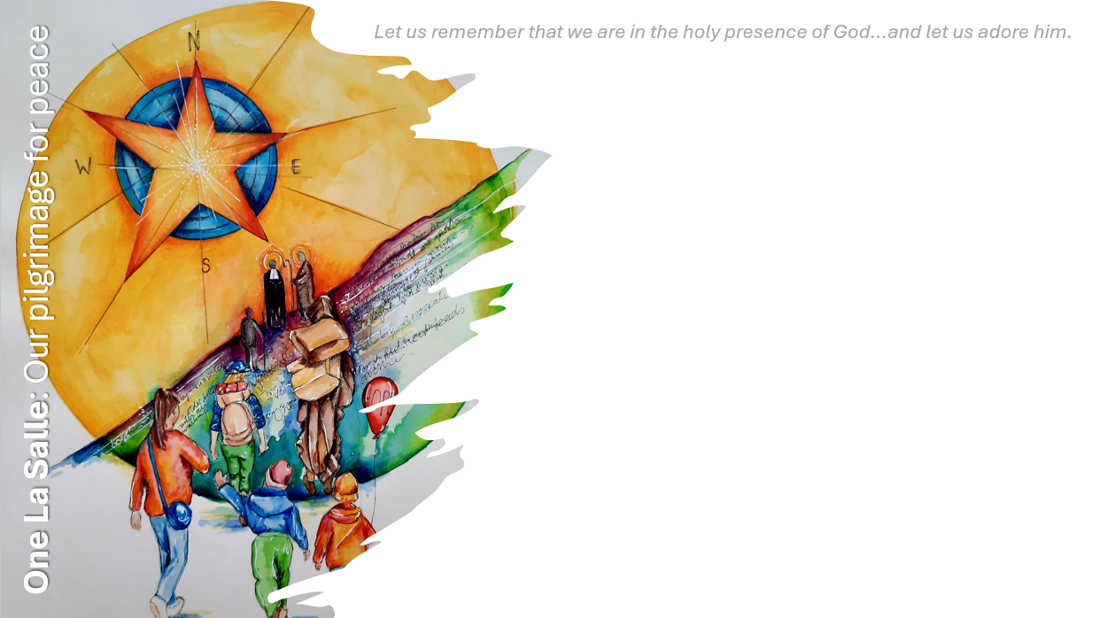
A message from the International Lasallian Commission on Youth
2024 has been a difficult year for peace in our world: there are several war situations in the Middle East- especially between Israel and Palestine- the war in the Ukraine continues, there are civil wars in Africa, and there is a lot of migration and displacement happening around the world due to poverty, conflict, violence, climate change, political instability and other issues.
More than ever, we as Lasallians need to be united as one charismatic family and to do something about this terrible situation: pray, donate and be part of civil organizations and volunteer programs. Our International Lasallian Days for Peace can be an opportunity to become active.

Slide 5
This year we try to connect the campaign with projects by the La Salle Global Foundation focusing on migration and displaced persons. The theme of the International Lasallian Days for Peace is: "1 La Salle, our Pilgrimage towards Peace".
On the one hand, the expression ‚One La Salle‘ underlines the idea that we are more than a network of educational ministries, we are one family and it is important to show solidarity with fellow Lasallians and make an effort towards global peace.
On the other hand, we would like to invite you to start a pilgrimage through some of the regions of the Institute and get to know experiences that build peace and fraternity, especially in the dramatic reality following migration and displacement.

Slide 6
Throughout the International Lasallian month for peace, we invite you to go on a pilgrimage of learning and discovery, finding out more about the Lasallian Mission all around the world.
We invite you to step out of your comfort zone, challenge yourself to find out more about fellow students who belong to your community and find ways to be welcoming and kind through your actions.
May we walk together, Brothers, Sisters, young adults, children, educators and those we are yet to meet. May we walk with an open heart and our eyes on the periphery.
May peace be with each one of you always.
IGBM District Young Lasallian Council

Slide 7
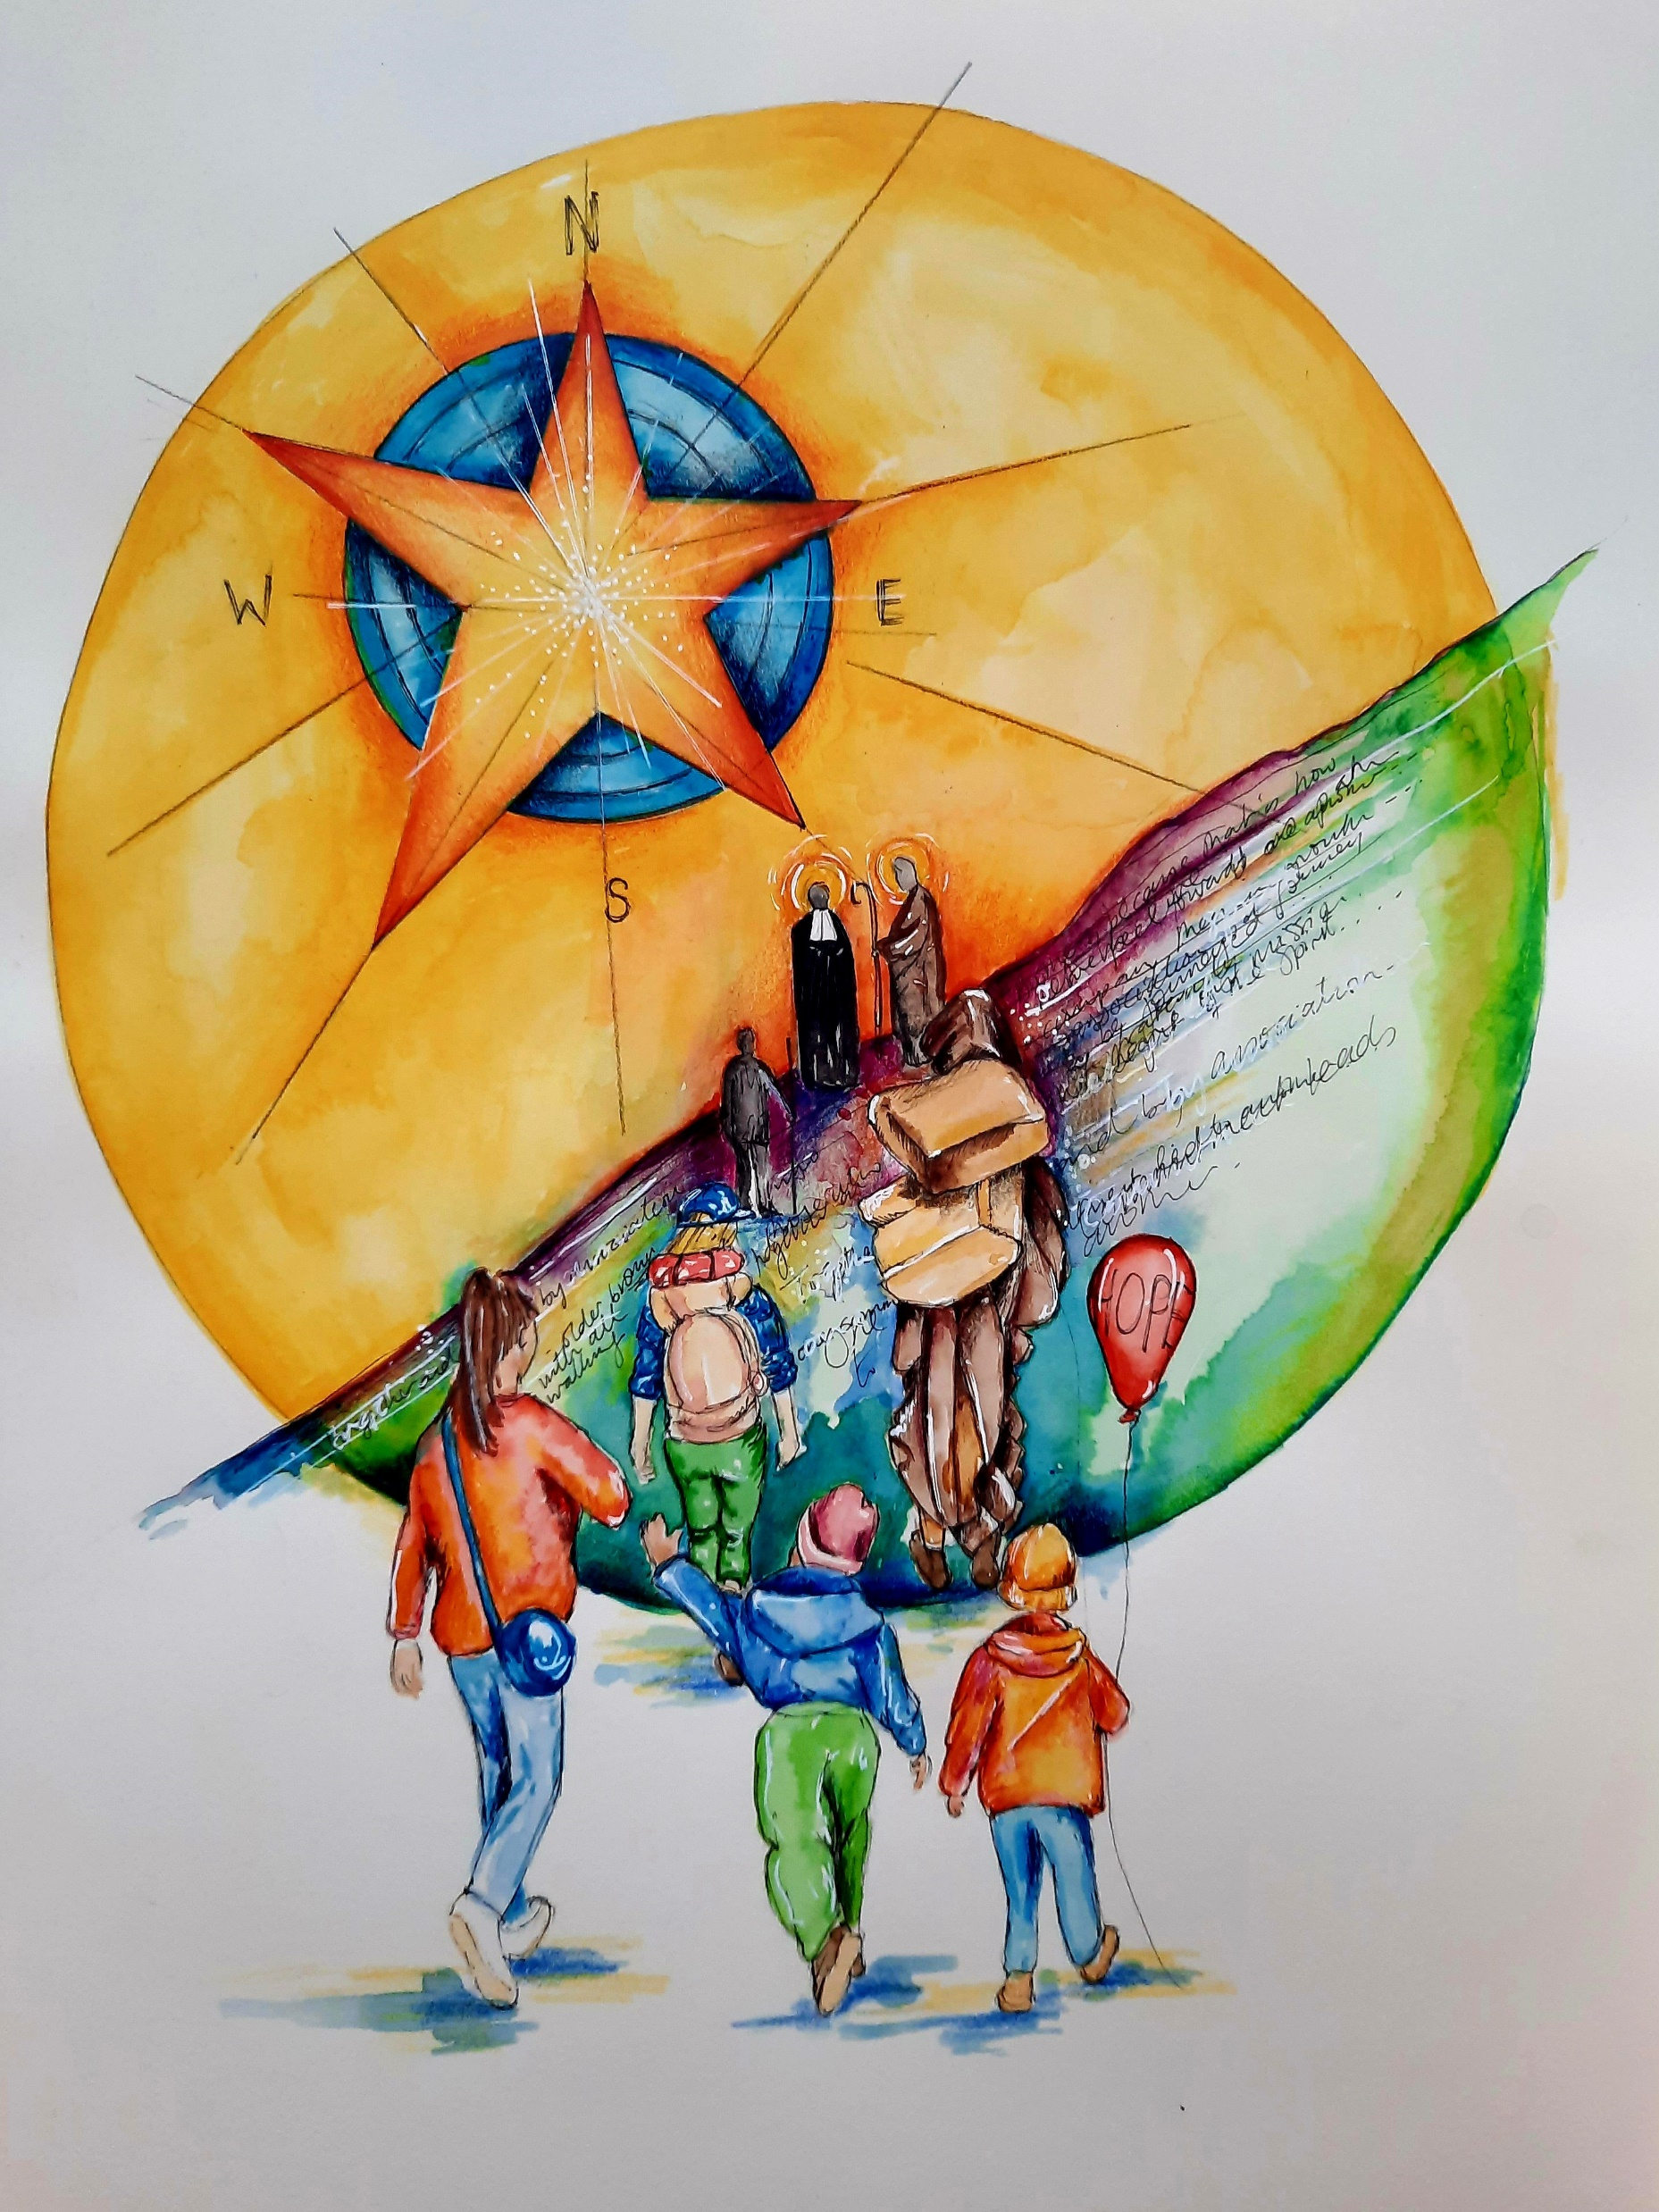
Take time to reflect on the message and the image shown here.
What does it mean to go on a pilgrimage?
Why is it important to walk together for peace?
Who do you see in the image?
Why are there bags? What might we need for a journey? (Think literally and spiritually)
What does the star and circle look like? What might this represent?
Why do you think a child might carry a balloon saying ‘hope’?

Slide 8
Be still and pray
The following slides are designed to be used in a pick and mix style. They are often based on one slide (although sometimes run across two or three) and can hopefully drop in to your prayer and liturgy for class groups or assemblies.
If you see a speaker icon, there is a song to play.
Slides are coded B1, B2 etc to highlight if any prayers are more than a single slide.

Slide 9

Today, we pause and pray as we listen to a song entitled Come as you are by David Leonard.
This is a song that reminds us that we are all welcome and we should all feel able to come as we each are without fear and without judgement.
As Lasallians, we each have a role to play in ensuring that every person in our community can come as they are.
Click to play
B1

Slide 10
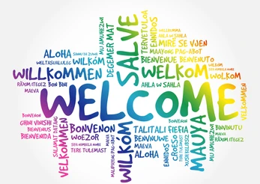
All are welcome to walk together as we begin our pilgrimage for peace.
Ask one another, how do you say welcome in each other’s languages? What does a welcoming body language look like?
Try to welcome each other using British Sign Language (BSL) found on the next slide.
B2

Slide 11

B2

Slide 12

B2

Slide 13
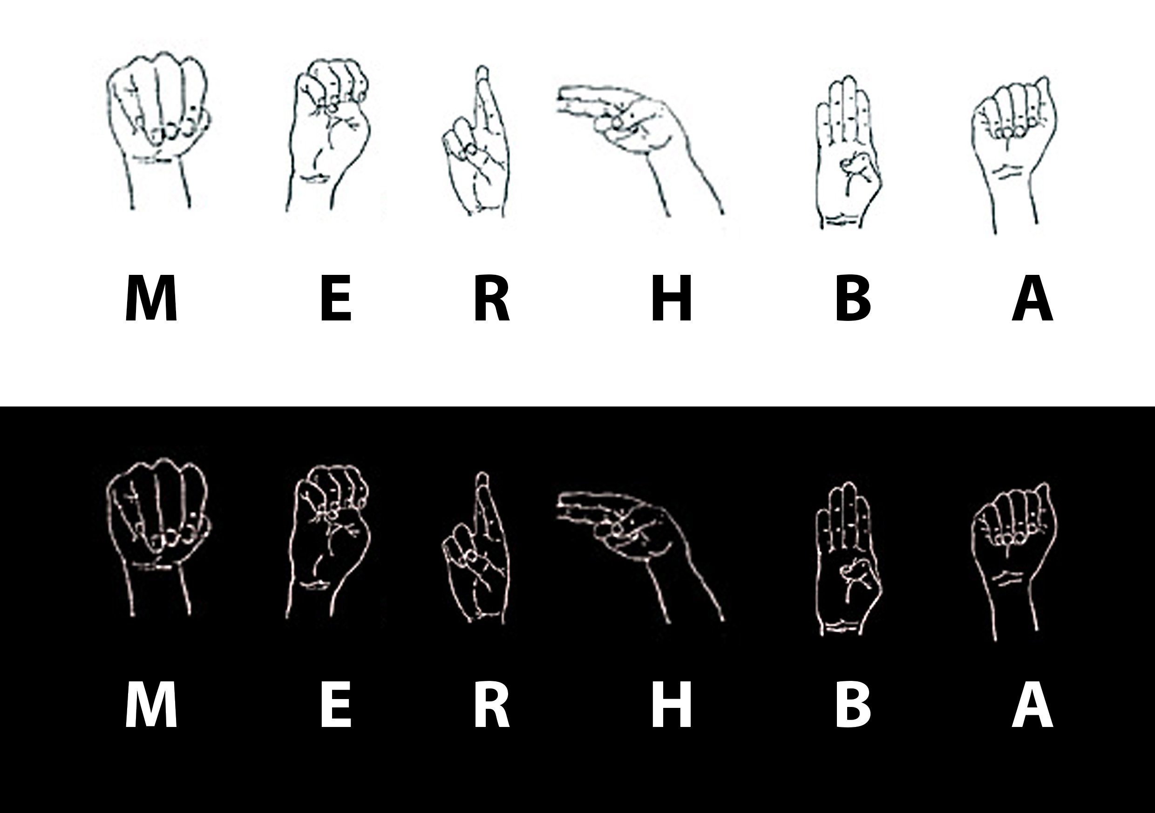
B2

Slide 14
Today, we pause and pray as we listen to a song entitled All belong here by The Many.
Sometimes we might not feel as though we belong. Often all it takes is for someone to reach out, offer an invitation, a friendly hello or a kind word to encourage belonging.
As Lasallians, we each have a role to play in ensuring that every person in our community feels seen and heard.
Click to play
B3

Slide 15
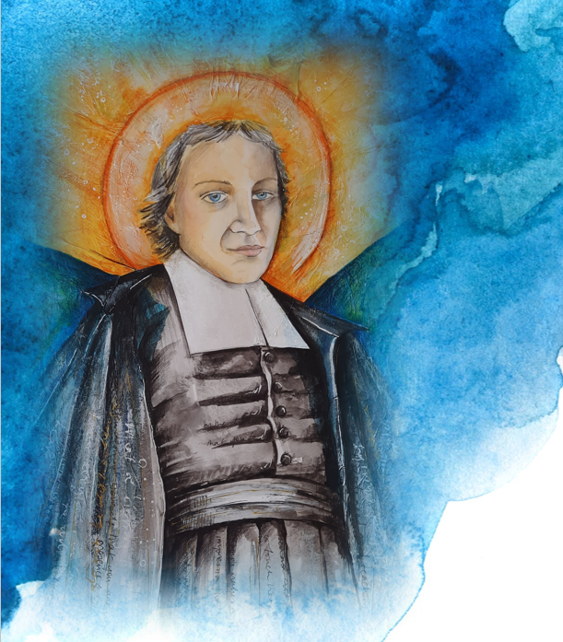
A Prayer for Peace
We are moulded, each one of us,
in the image of God,
and within our souls there is a fingerprint
none can erase.
We pray for those who have no regard
for anyone but self,
who put no value on human life.
For nations and individuals who abuse and kill.
We are not called to be judge or jury,
but we are called to be agents of change,
and if the butterfly that flaps its wings
should be our attitude to others
then so be it, Lord,
and may the hurricane this generates
somewhere within the world
reach into the hearts and souls of those
for whom we pray, and reveal to them
how precious are those
for whom they have no love,
and how precious are they
who now bring tears to the eyes of God.
- John Birch
B4

Slide 16
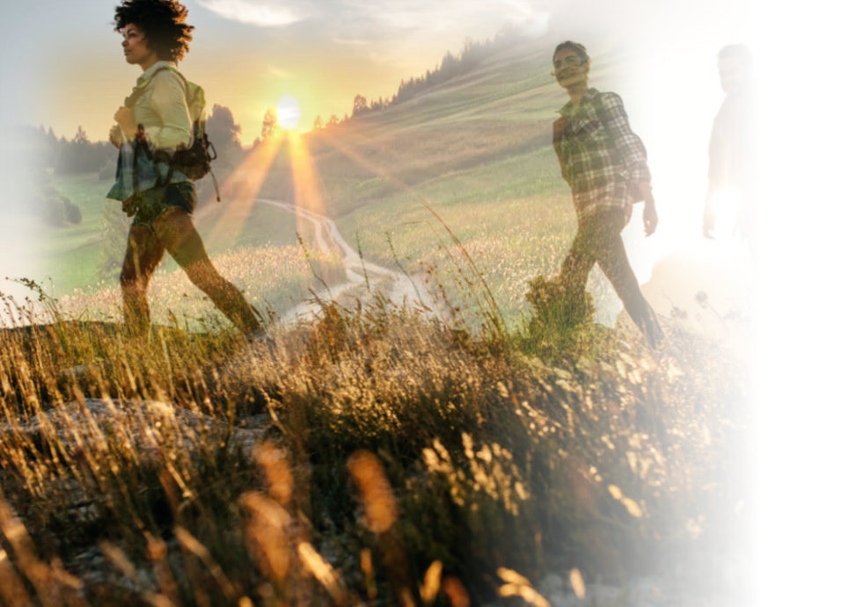
A PRAYER FOR PILGRIMS AND JOURNEYERS
A journey once taken alone we now choose to take together.
Moving forward as one body into a future filled with possibility, we walk without maps, but we walk confidently, and we walk with hope, because we have chosen to be lights for each other, while on the way.
We travel forward along a way we have not gone before; we travel as one who is led, arms outstretched, as one who is called forth to life. We travel in need, dependent on the Lord for strength, for assurance; dependent on each other, God's instruments, for love.
Leaving known paths behind us, we choose to journey forward in faith and service. As the journey brought us here, so now we begin it anew, in company.
John O’ Donohue
B4

Slide 17
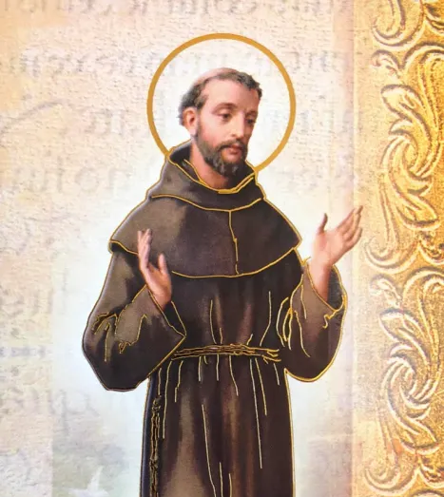
The prayer of St Francis is a beautiful reminder of what peace looks like in everyday life. This is such an encouraging and uplifting prayer that teaches us how we can live like Jesus Christ and serve those around us, putting the needs of others first.
Lord, make me an instrument of your peace,
Where there is hatred, let me sow love;
Where there is injury, pardon;
Where there is doubt, faith;
Where there is despair, hope;
Where there is darkness, light;
Where there is sadness, joy;
O Divine Master,
Grant that I may not so much seek
To be consoled as to console;
To be understood as to understand;
To be loved as to love.
For it is in giving that we receive;
It is in pardoning that we are pardoned;
And it is in dying that we are born to eternal life.
B5

Slide 18

Let us remember that we are in the holy presence of God…and let us adore him.
Pope Francis has announced that 2025 will be a year of Jubilee, something which happens every 25 years.
The theme is “Pilgrims of Hope”, and it will be a year of hope for a world suffering the impacts of war, the ongoing effects of COVID-19 pandemic, and a climate crisis.
Pause for a moment of reflection as you listen to the official hymn for ‘Pilgrims of Hope’.
Click to play
B9

Slide 19
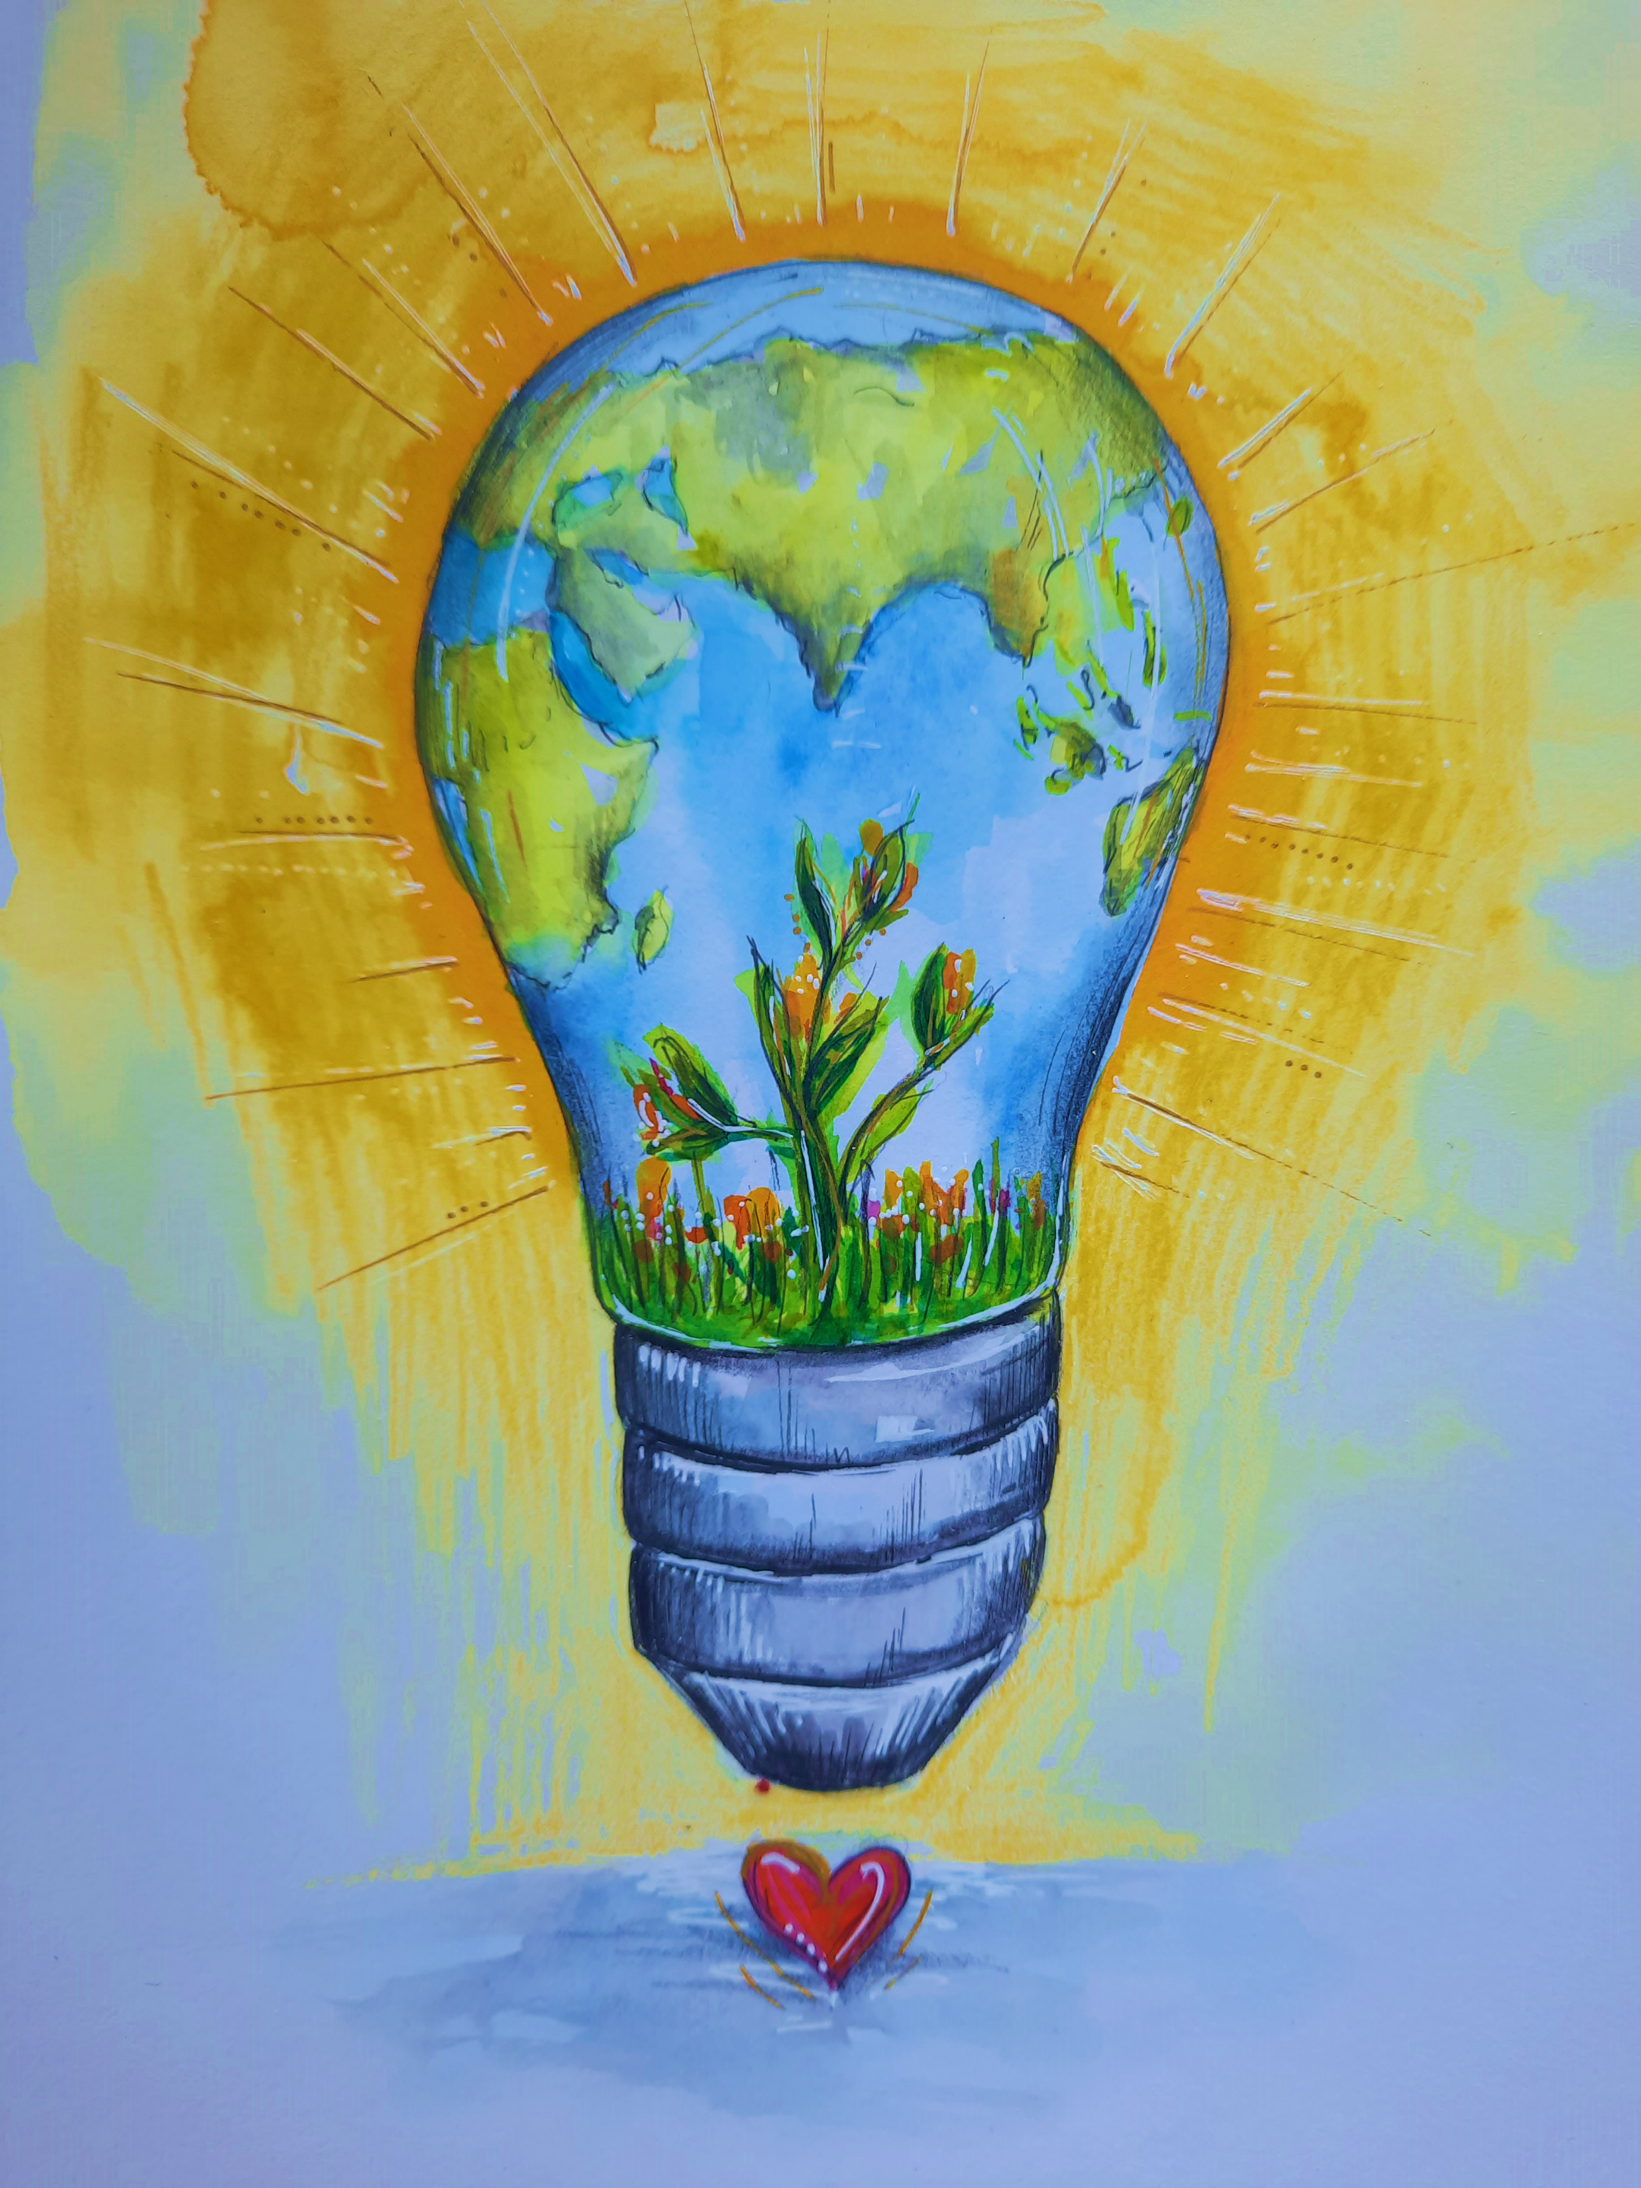
Lasallians, we are called to act. We are called to live deeply within the realities and signs of the times that we are faced with, and to not allow the injustices and threats to peace that we may encounter, become like wallpaper or background noise. May our faith, and our Lasallian community, nurture the beautiful seed of purpose that is inside of each of us, and provide the light it needs to grow.
For the young people entrusted to our care, the ones who bring their chaos and turmoil into our school communities, may we not turn away but shine our light on them so that they may experience peace through the example and love shown to them.
For the news that saddens us and is painful to watch or to hear, may we not ignore this but shine our light in this area and use education to transform future generations.
When faced with injustice or discrimination, may we be filled with the strength necessary to shine our light for all to see and call this out.
Seeds of peace will grow if they are nurtured, fed and provided with the warmth and light that they need. As Lasallians, may our focus go where it is needed most in our lives and have the courage to shine our light brightly so that we build communities that do not allow dark corners of hatred, pain and injustice to take root.
B6

Slide 20
A poem written by Heleina Ballsteros, a 16 year old student from De La Salle School, St Helens, GB. This poem reflects on Heleina making sense of her identity having roots in the Phillipines and now living in GB.
Who am I?
Perhaps I was born mismatched to those I grew up with
To my parents, my existence is all to give.
Torn apart between two countries
My place of growth, one of birth
Misplaced for what it’s worth
Where do I really belong?
In the polluted British air and activity
Or amid 8,000 miles far in similarity
B7

Slide 21
One a thalassophile
Endured to the vast tropical ocean
Enlightened with such bucolic emotion
Encircled among the peace of a humid drift
Feeling organic and true
Spectating far into the stretch; the sunset hue
With respect in regards to it’s creation
B7

Slide 22
One a cosmopolitan
Mesmerized by the richness of the metropolis glow
Masterpieces of history, as I grow and grow
Memories assembled upon recreation and life
Inspired ambitions established and dreamt upon
As of career, Ideas, humanity come together in unison
To birth a superior future
B7

Slide 23
I am one; but a fragment of two.
An influence to inevitably question myself who
I am indifferent, unique, just like the rest
Split into two parts, together in parallel
Riding along a never ending carousel.
There is no “home” nor “place”
Home is within me: my heart,
Taking every piece of me apart.
Who am I?
What struck you throughout this poem?
Did any aspects resonate with you?
Read the poem again, which line stands out to you the most?
B7

Slide 24
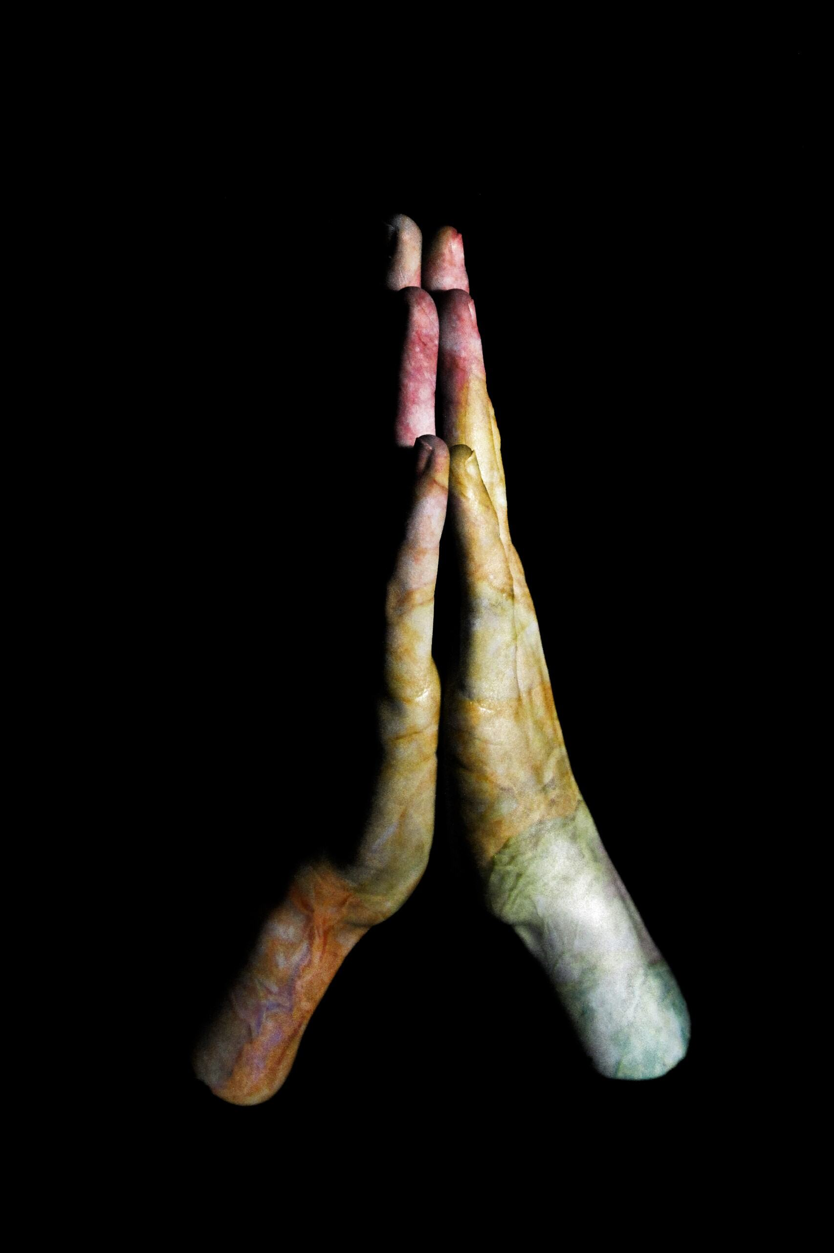


Let us remember that we are in the holy presence of God…and let us adore him.
When young people come together, powerful things happen. Take a look here at a Peace Protest led by young people in Ghana during the PeaceJam conference.
B8

Slide 25
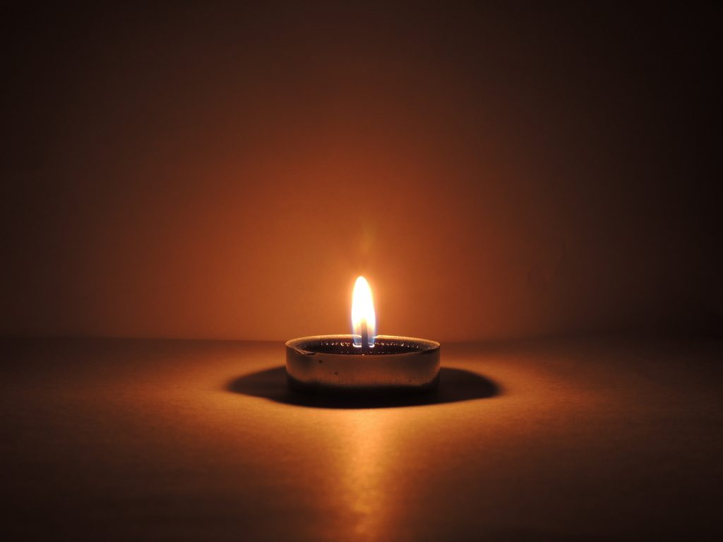
Let us remember that we are in the holy presence of God…and let us adore him.
Today, we pause and pray as we listen to a song entitled Go light your world by Chris Rice.
This is a song that reminds us that the light inside each one of can brighten so many lives if nurture the flame within.
As Lasallians, we each have a role to play in ensuring that every person in our community can shine brightly and feel at peace with who they are.
Click to play
B10

Slide 26
The Lasallian Global Mission
Here are one slide excerpts from ‘One Year in Mission together’
https://drive.google.com/file/d/1E2lEgrDKj7VDF87l8l0ZWSDNbMFzn_qX/view?usp=sharing
This highlights the variety of Lasallian projects which exist around the world.

Slide 27
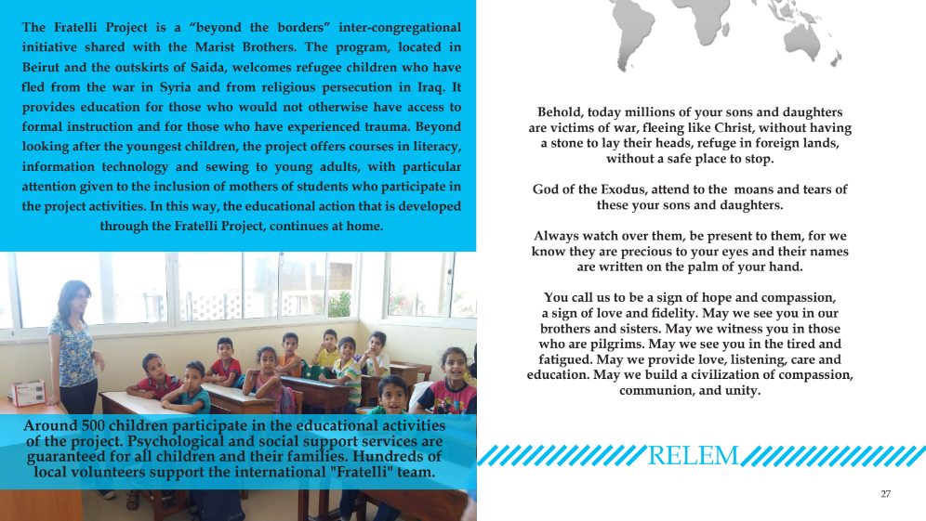
The Fratelli Project
Lebanon
C1

Slide 28
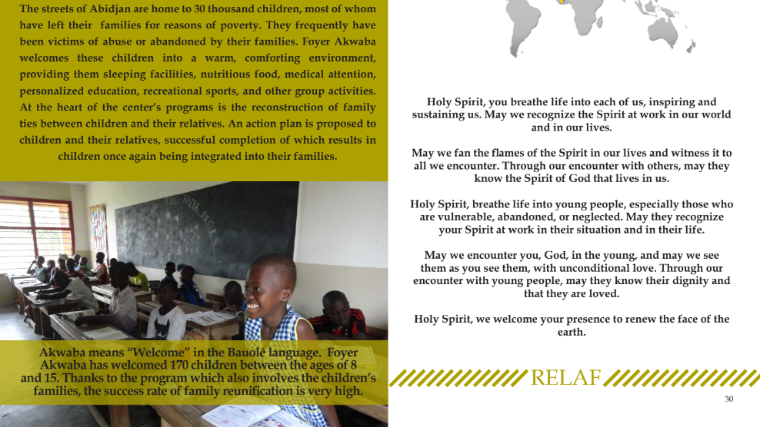
Foyer Akwaba
Abidjan Lagune, Ivory Coast
C2

Slide 29
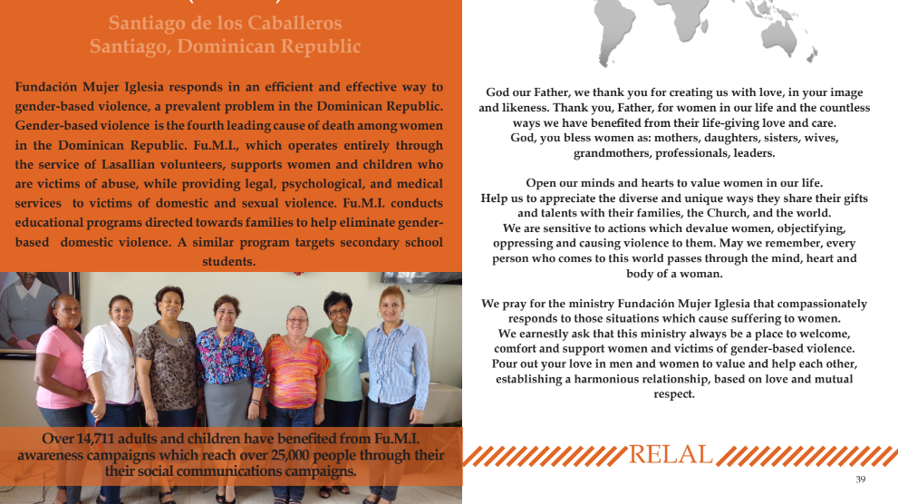
Fighting against gener based violence,
funacion Mujer Iglesia
(Fu.M.I)
C3

Slide 30
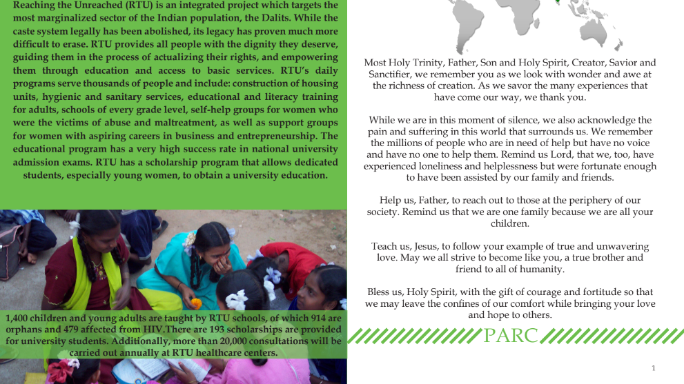
Reaching the Unreached – RTU
Madurai, Tamil Nadu, India
C4

Slide 31
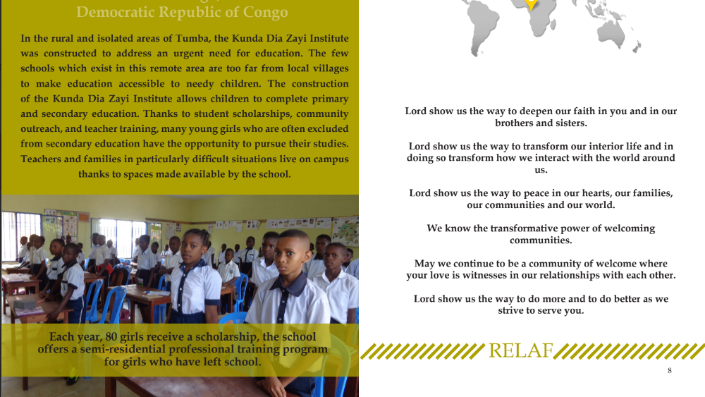
Institute Tumba
Kunda Dia Zayi
C5

Slide 32
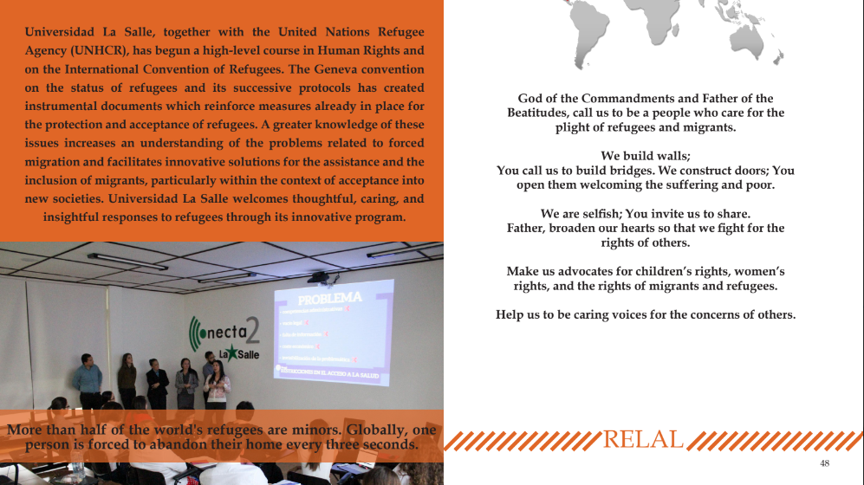
Universidad La Salle
San Jose, Costa Rica
C6

Slide 33
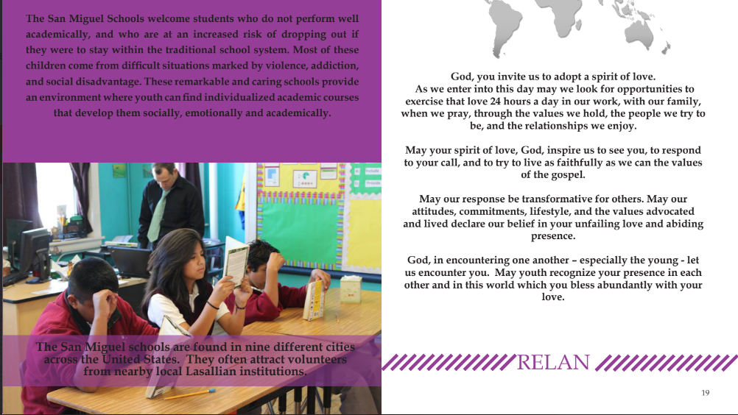
San Miguel Schools
USA
C7

Slide 34
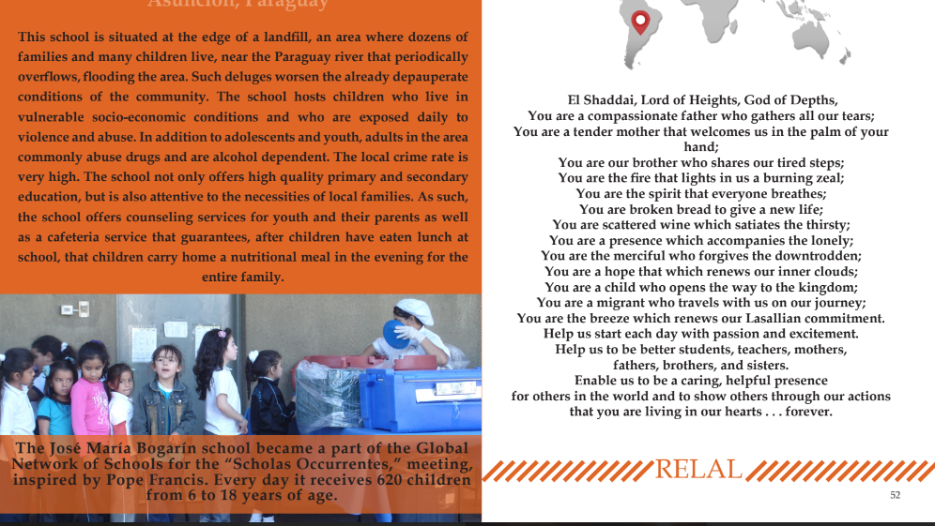
Escuela Jose Maria Bogarin
Asuncion, Paraguay
C8

Slide 35
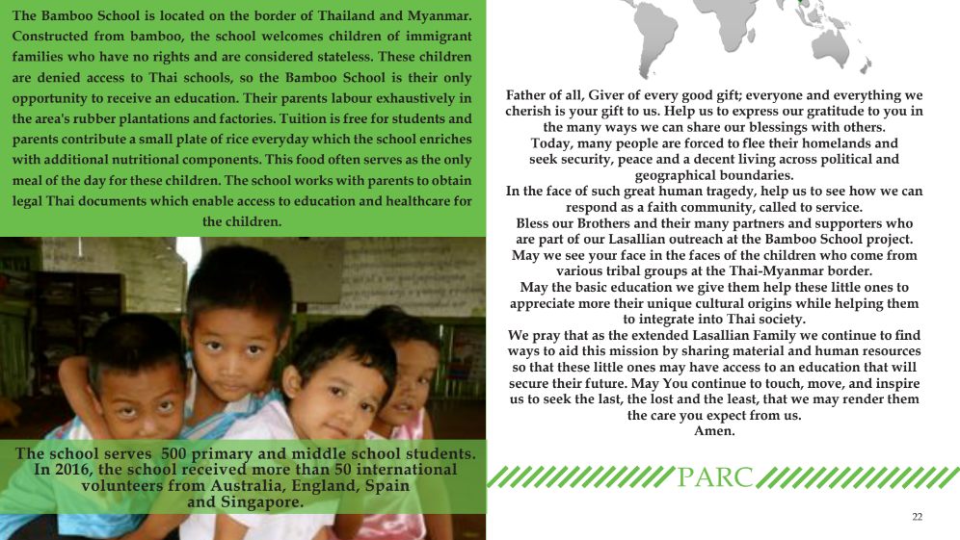
Bamboo School
Three Pagodas Pass, Kanchanaburi, Thailand
C9

Slide 36
Find out more about projects that the Lasallian Mission serves.
https://www.lasalle.org/en/lasallian-reflection-10-our-heart-is-in-the-peripheries/
Volunteer opportunities in India
https://drive.google.com/file/d/1DWU4Bb6Tv76-wvtAmb7Ufbxe9up7aHhU/view?usp=sharing
One Year in Mission together
https://drive.google.com/file/d/1E2lEgrDKj7VDF87l8l0ZWSDNbMFzn_qX/view?usp=sharing
Solidarity projects
https://www.lasalle.org/en/?s=solidarity&lang=en
https://www.lasallefoundation.org/wp-content/uploads/2024/07/Report-2023-EN-web.pdf
https://www.asylumspeakers.com/ Useful website, with a beautiful children’s book called Bobble, designed to help with conversations about migration.

Slide 37
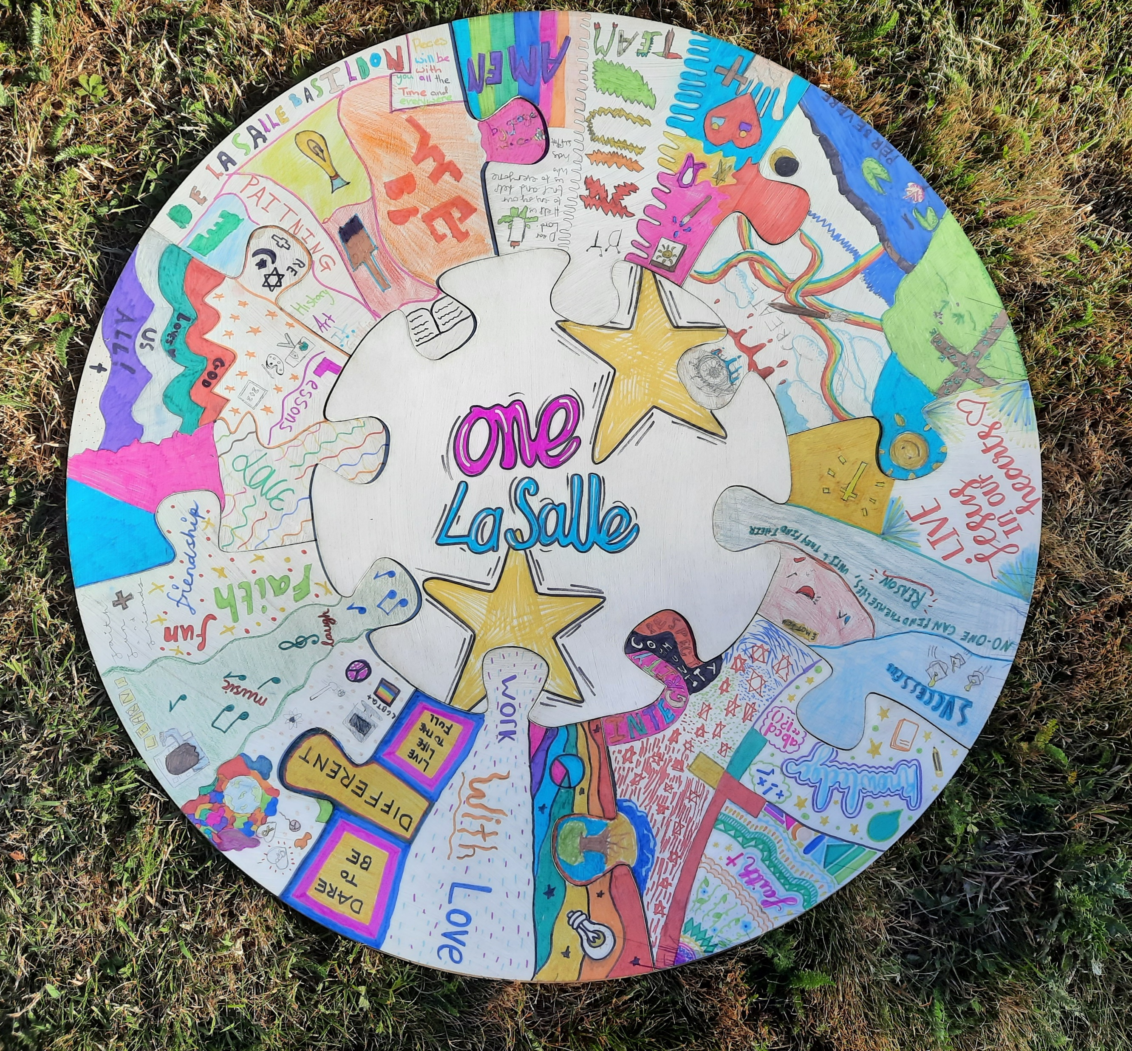
Create for peace
Here are some suggestions for creative activities during ILDP.
Please find instructions and templates in a separate document.

Slide 38
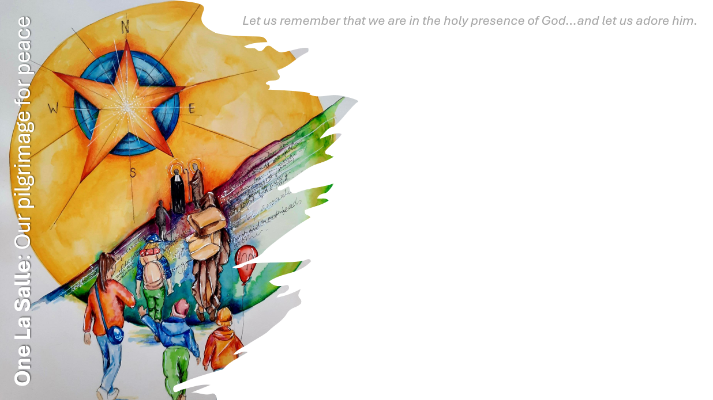


The dove is a symbol that is used all around the world to represent peace.
It is time to get creative and create your own doves to display in your classroom as a symbol of your quest for peace.
Please see creative activity pack for templates and guidance.

Slide 39
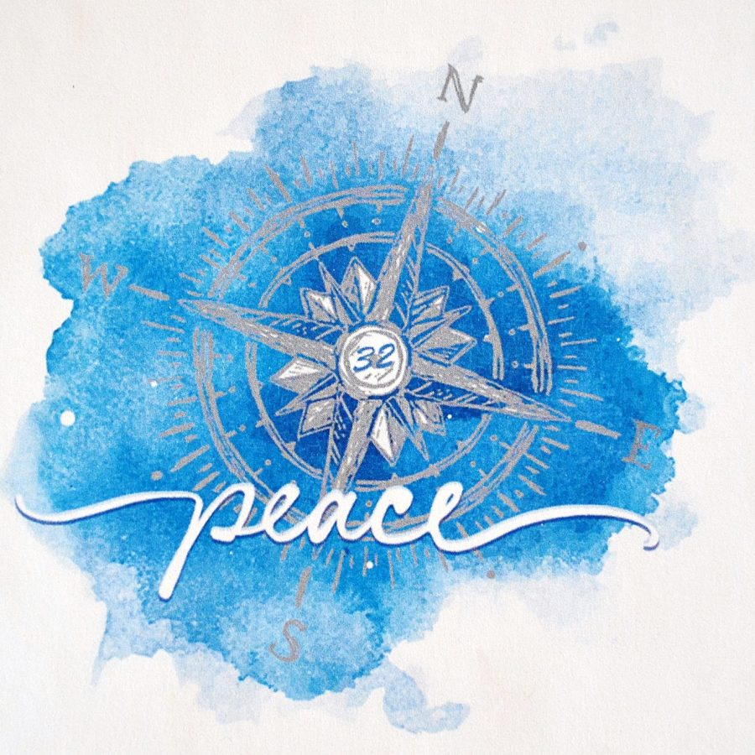

A compass is used to help navigate your way when travelling. You may also hear ‘moral compass’ referred to which talks about a different set of skills, qualities or values needed in life.
It is time to get creative and create your own compass to display in your classroom as a symbol of your pilgrimage for peace.

Slide 40
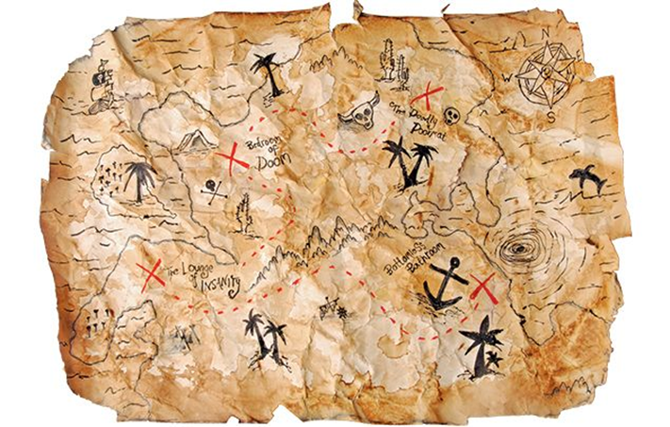
Maps are used to help us to know where we are in the world. When setting off on a new journey, a map will help to know which direction to take. If our destination is peace, what might the journey towards peace look like? What might you have to overcome?
It is time to get creative and create your own map to display in your classroom as a symbol of your journey towards peace.

Slide 41
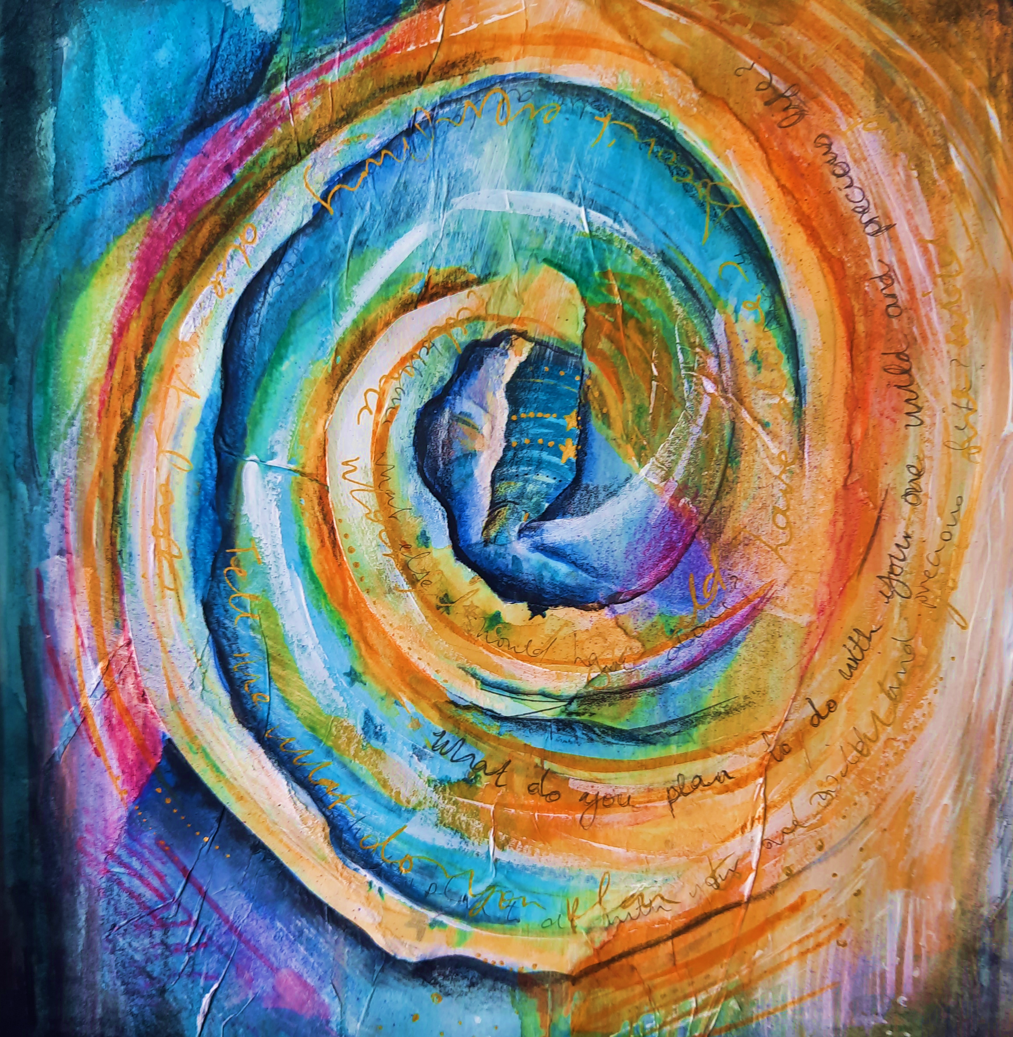
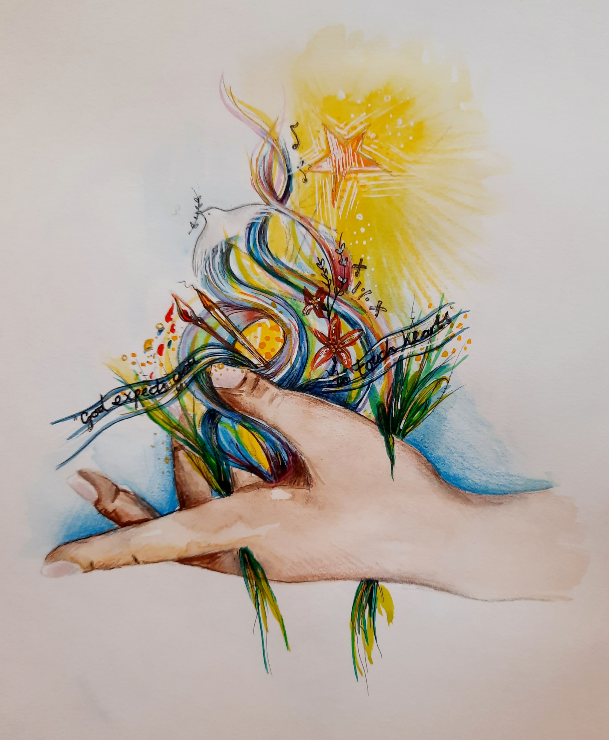


International Lasallian days for Peace
2024

