Slide 1

Week 1: Peace
Fratelli Project Lebanon
September 23-27

Slide 2
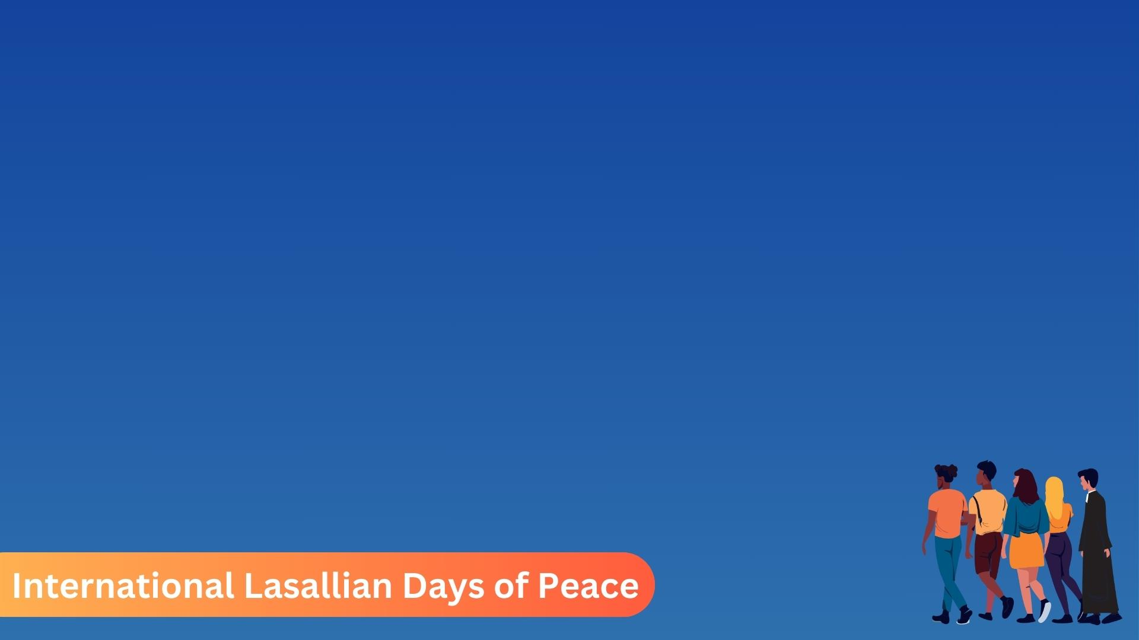
Activities- Younger students
Template 1 shows a template of a dove. The teacher can explain that the dove is an international symbol of peace. The students will be given a template each which they will cut out. The students can then write down words that they relate to the word peace (Example: Friendship, Love, Happiness,…). The students can also colour and design their dove to their likings. The doves can then be placed on a noticeboard in class or stuck to the walls.

Slide 3
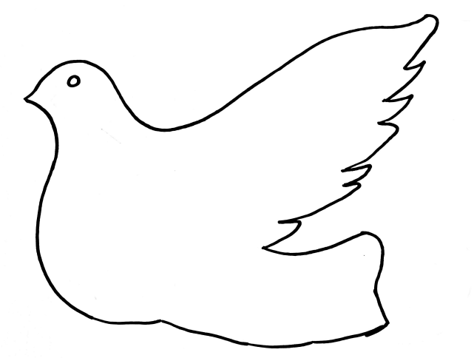
Template 1

Slide 4
Activities- Older students
For the students who are more capable, rather than having a 2D dove, they can make a 3D dove. The students will be given template 2 where the students will use the template together with another half of an A4 paper and fold it in a similar fashion as when doing a ‘fan’. A cut is then made in the dove through which the folded paper is then passed through. A string can also be passed through the wings so from which the dove can be hung in the classroom. Once again, the students can choose to write some words that they relate to peace. The older students can also write down a small reflection. This reflection can be in the shape of a prayer, a poem, a description of an experience related to peace, or just some thoughts on peace in general.

Slide 5

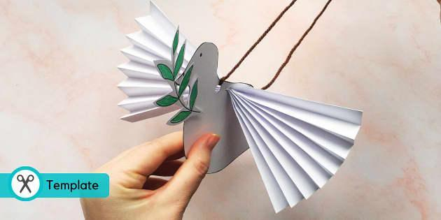
Example- activity for older students

Slide 6
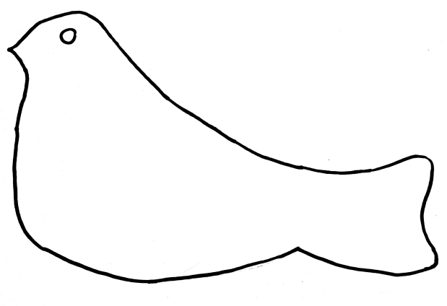
Template 2

Slide 7
A prayer for peace.
and if the butterfly that flaps its wings should be our attitude to others then so be it, Lord, and may the hurricane this generates somewhere within the world reach into the hearts and souls of those for whom we pray, and reveal to them how precious are those for whom they have no love, and how precious are they who now bring tears to the eyes of God.
- John Birch
We are moulded, each one of us,
in the image of God,
and within our souls there is a fingerprint
none can erase.
We pray for those who have no regard
for anyone but self,
who put no value on human life.
For nations and individuals who abuse and kill.
We are not called to be judge or jury,
but we are called to be agents of change,

Slide 8

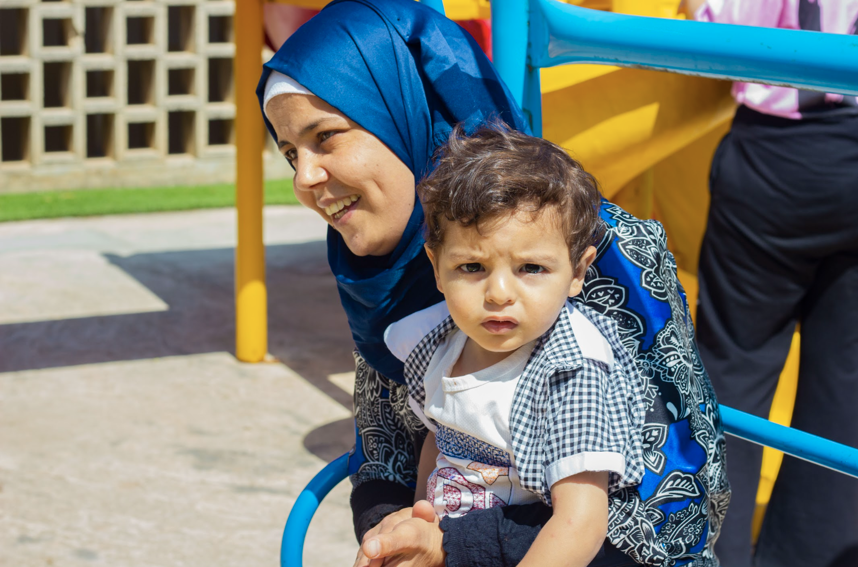
Fratelli Project in Lebanon a way for the peace
Click here for see the video.
Click here for see the report and know more about this project.

Slide 9


Special thanks for your collaboration

