Slide 1

Week 2: Pilgrimage
Bamboo School
September 30 - October 4

Slide 2

Activities- Younger students
Bag craft. Student will be given an A4 paper which they will fold and staple at the edges to form a pouch. Using another A4 paper which will be shared among students, two strips of paper will be cut to form the straps of a bag. The students will then either write on small pieces of paper or draw, different objects that a pilgrim would need for their voyage (example: torch, map, compass,…). These objects will then be placed in the bag created. The bag can then be coloured and designed to the students liking with the name of each student and the words: Pilgrimage bag on the front.

Slide 3
Activities- Older students
Compass craft. Each student will be given an A5 cardboard paper. The students will need to cut a circular shape of a compass and a rectangular arrow for the pin of the compass. After cutting a hole in the compass, a butterfly pin is used to put everything together.
The aim of this activity is to help the students understand that pilgrims require a compass for their physical journey but also require their faith for their religious part of the pilgrimage.

Slide 4

Example- activity for older students

Slide 5
A Prayer for World Peace
We pray for the vision to see and the faith to believe
in a world emancipated from violence,
a new world where fear shall no longer lead men or women to commit injustice,
nor selfishness make them bring suffering to others.
Help us to devote our whole life and thought and energy
to the task of making peace,
praying always for the inspiration and the power
to fulfill the destiny for which we and all men and women were created.
- Author Unknown, Offered by Beth Amyot
We pray for the power to be gentle;
the strength to be forgiving;
the patience to be understanding;
and the endurance to accept the consequences
of holding on to what we believe to be right.
May we put our trust in the power of good to overcome evil
and the power of love to overcome hatred.

Slide 6
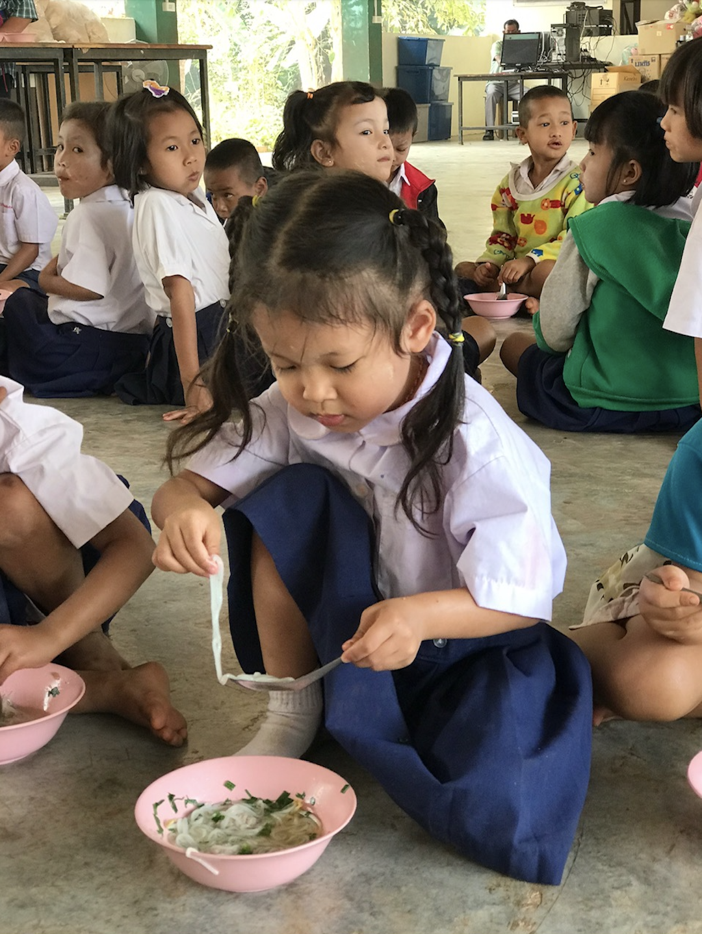
Bamboo School a way for the peace
Click here for see the photos.
Click here for see one video about Bamboo School.

Slide 7


Special thanks for your collaboration

