Slide 1
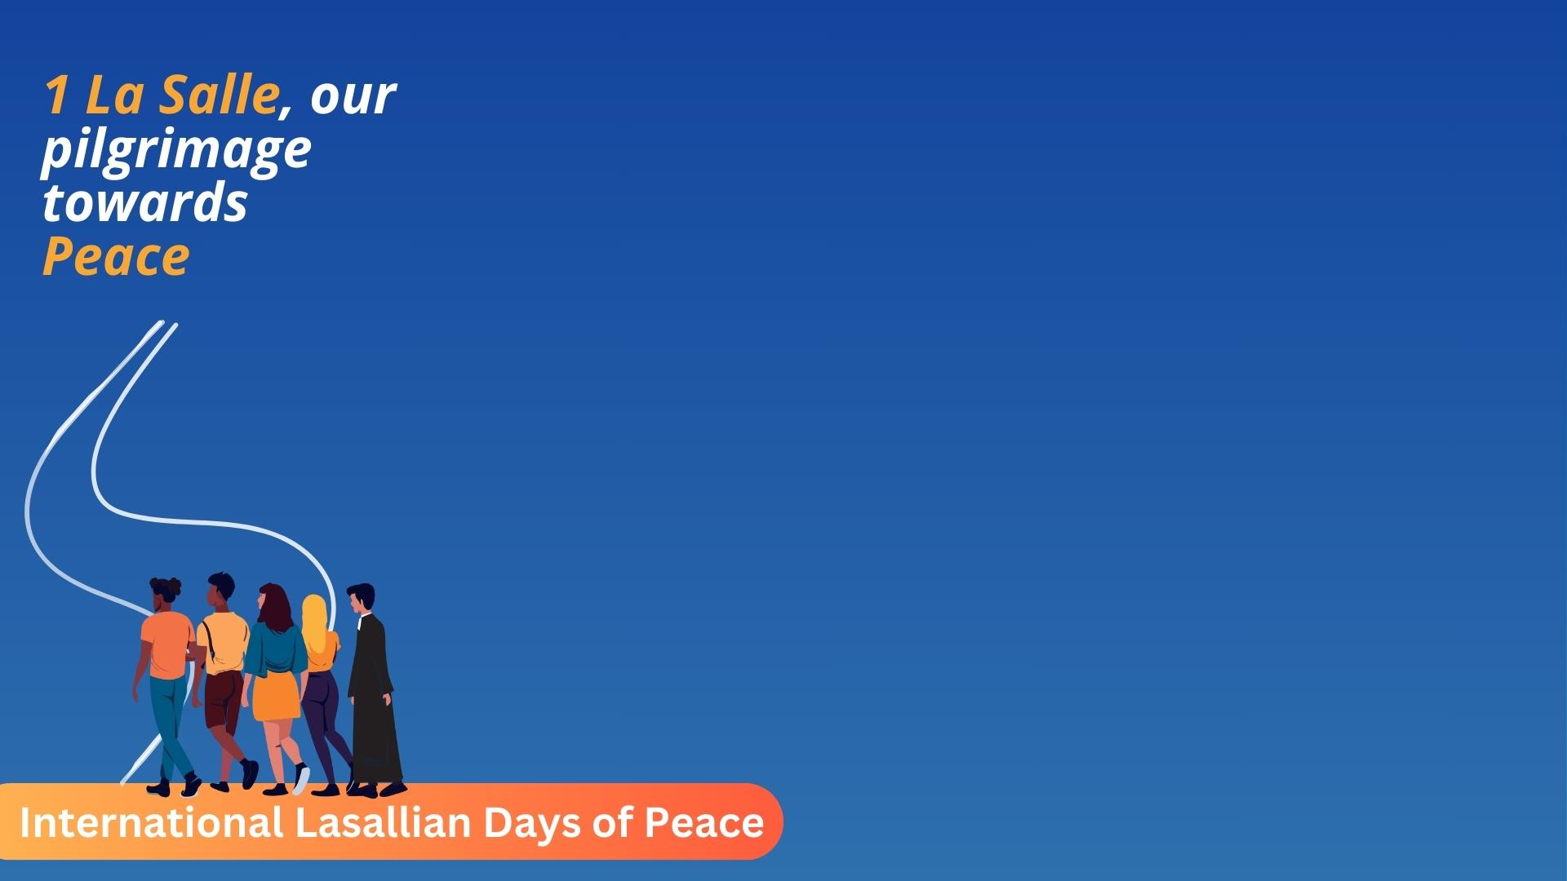
Week 3: Our Pilgrimage towards Peace
Fratelli Projet Maicao
October 7 - 11

Slide 2
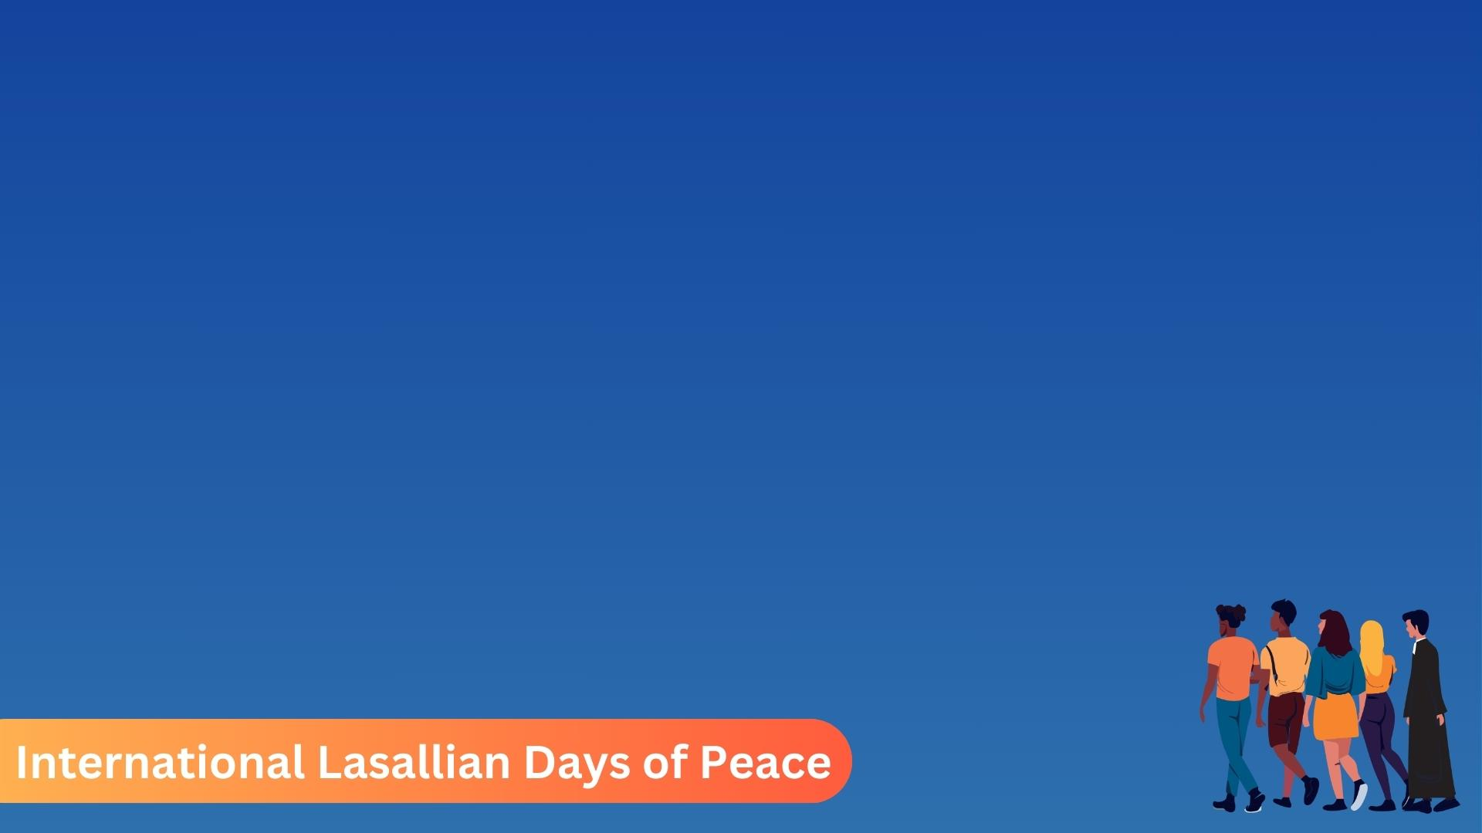
Activities- All students
Map/List of things to achieve peace. Each student will be given an A4 paper. Using a wet tea bag, the student will transform the paper into a papyrus type of paper. After it dries, the younger students can then list things as well as draw pictures of things that they can do to achieve peace with other (example: help each other, include everyone,…) while the older students can create a map that symbolises the planning that is required for the pilgrimage to peace. They can draw or list much more deep thoughts than the younger students and so we should encourage them to think deeply. The map can also include stops in the journey where the students are working on finding peace within themselves (example: prayer, reflection,…).

Slide 3
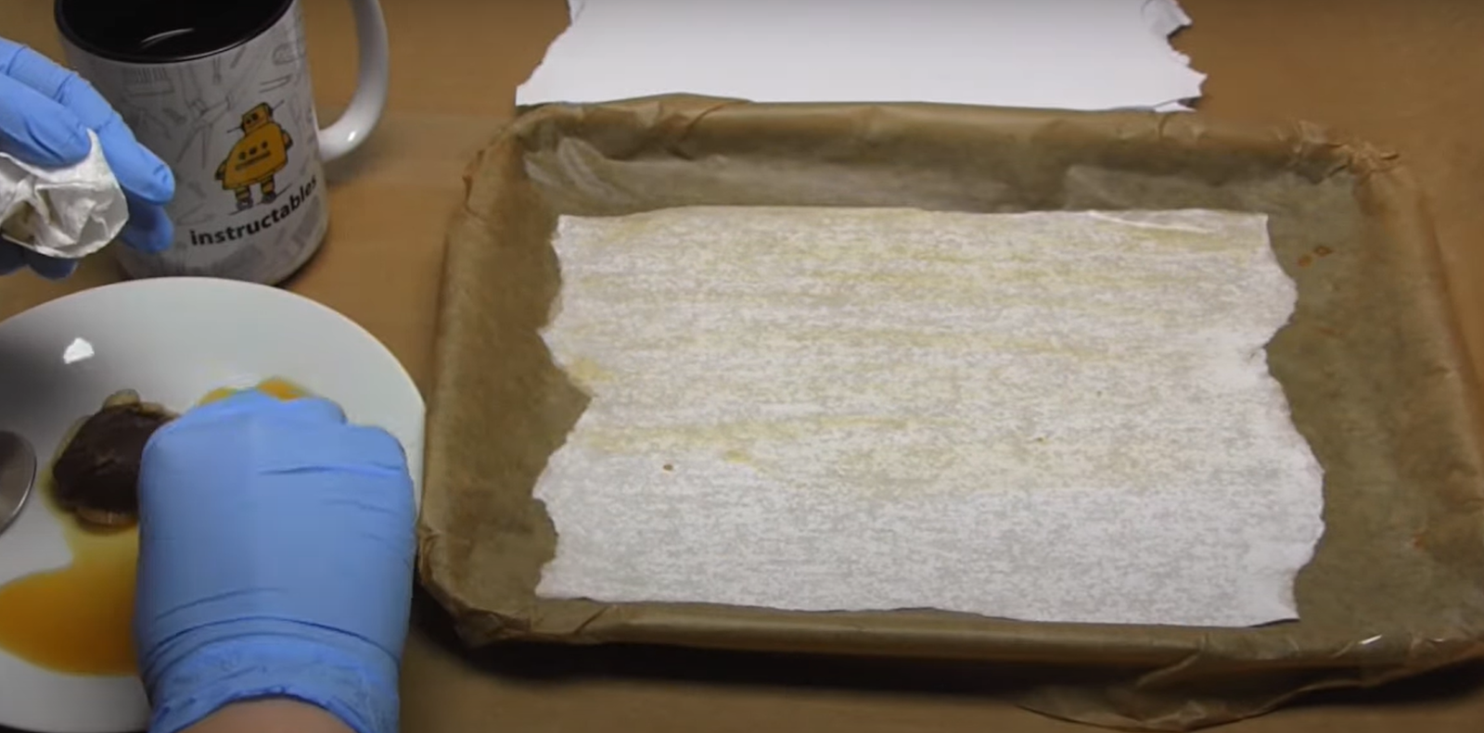
Example- activity for all students

Slide 4
Christian Prayer for Peace
Give to everyone who begs from you, and of those who take away your goods, do not ask for them again. And as you wish that others would do to you, do so to them.
- Author Unknown
Blessed are the Peacemakers, for they shall be known as the Children of God.
But I say to you that hear, love your enemies, do good to those who hate you, bless those who curse you, pray for those who abuse you.
To those who strike you on the cheek, offer the other also, and from those who take away your cloak, do not withhold your coat as well.

Slide 5
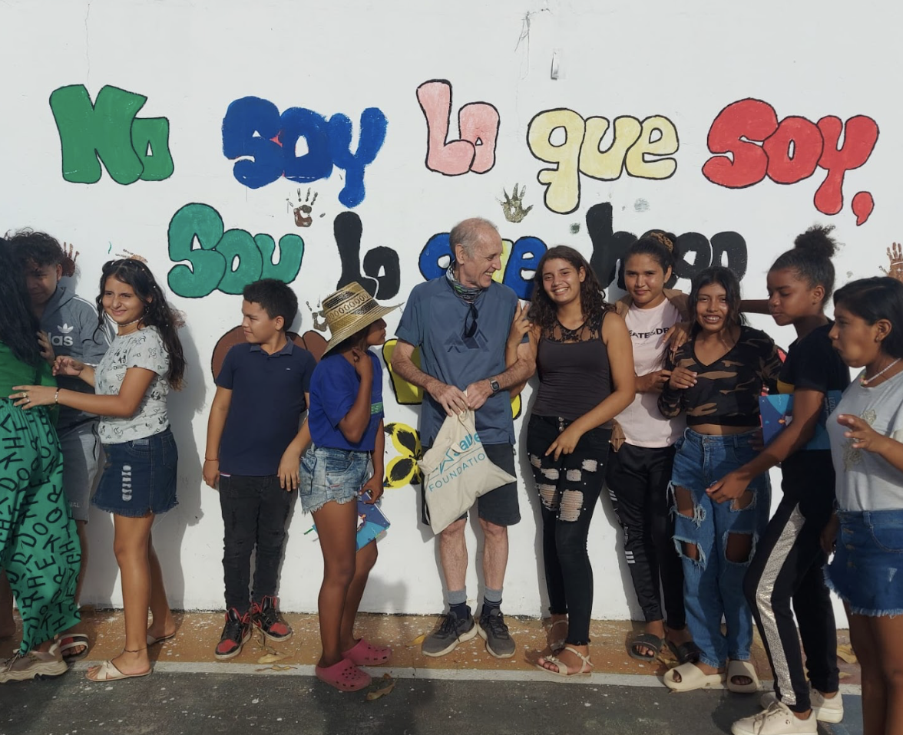
Fratelli Project Maicao a way for the peace
Click here for see the photos.
Click here for see one video about Fratelli Project Macao.

Slide 6


Special thanks for your collaboration

