Slide 1
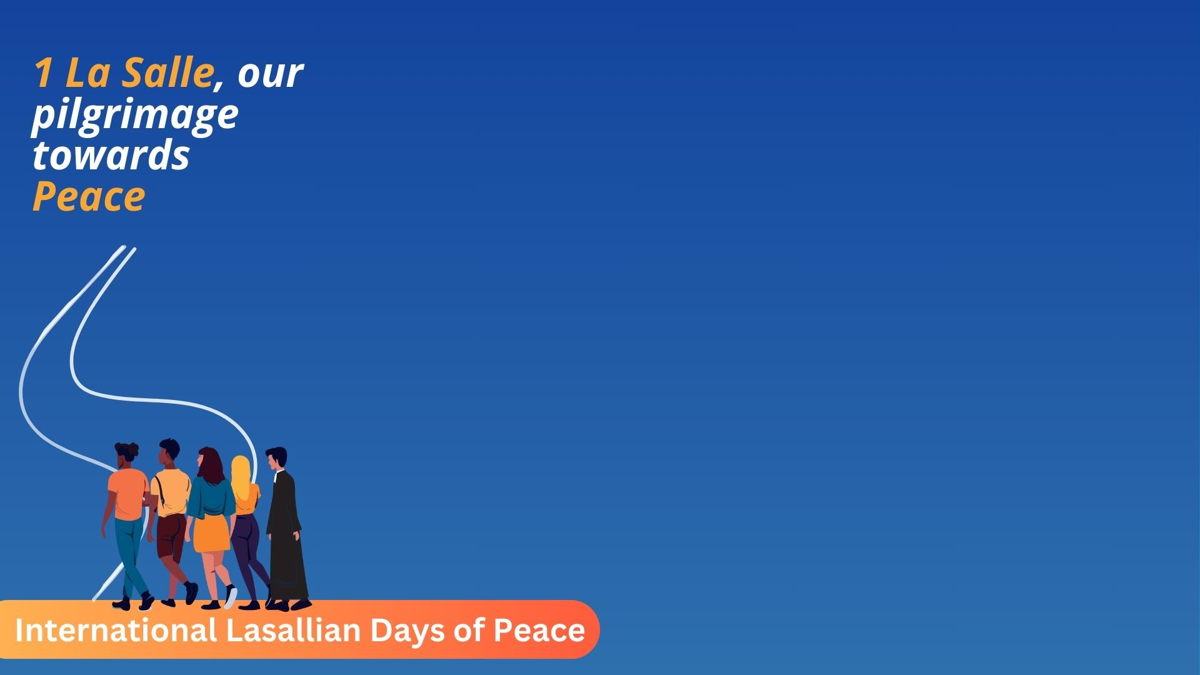
Week 4: 1 La Salle, Our Pilgrimage towards Peace
Rumbek, South Sudan
October 14 - 18

Slide 2
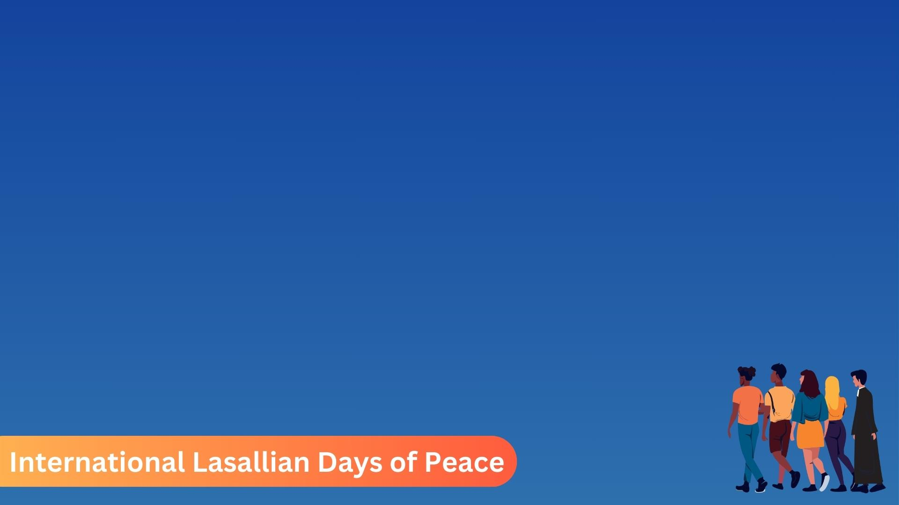
Activities- All students
Both the young and older students will be doing the same activity however for the older students, they will require more reflection.
The students will be given an A4 paper and by folding, make people that are connected to each other similar to the following video: https://www.youtube.com/watch?v=kZo68K6vWZ4
The younger students will simply colour the people and write down the 5 core principles.
The older students will do the same but also add a reflection on the other side of each people on how the core principles relate to peace.

Slide 3
Prayer for Peace
Renew for us the wonders of your MERCY; send forth your Spirit hat He may work in the intimacy of our hearts, that enemies may begin to dialogue, that adversaries may shake hands and peoples may encounter one another in harmony. May all commit themselves to the sincere search for true peace which will extinguish all arguments, for charity which overcomes hatred, for pardon which disarms revenge.
- Pope John Paul II
O God, Creator of the universe, who extends your paternal concern over every creature and guides the events of history to goals of salvation, we acknowledge your Fatherly love when you break the resistance of mankind and, in a world torn by strife and discord, you make us ready for reconciliation.

Slide 4
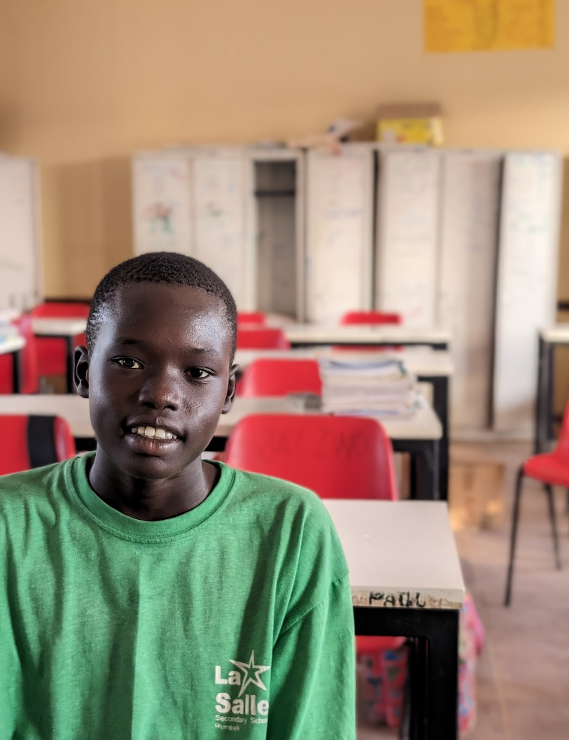
Rumbek, South Sudan a way for the peace
Click here for see the photos.
Click here for see one video about Rumbek, South Sudan

Slide 5


Special thanks for your collaboration

